Slide 1
IoT Solution for Shopper Foot Traffic
Case Study
LOO HAN PIN

Slide 2
PROBLEM STATEMENT
Client’s Demand
Foot Traffic
IoT Architecture
To understand foot traffic of shoppers in their stores across the nation using IoT.
How do we capture or measure foot traffic?
How does the foot traffic data flows?

Slide 3
“Foot traffic is a term used in business to describe the number of customers that enter a store, mall, or location.”
— Investopedia (2021)

Slide 4
Proposed Solution

Slide 5
IoT Architecture
Sensor/Device
Edge Analytics
Acquire, filter and convert sensor data before sending data to cloud platforms.
Store, process and analyze massive data volume to for complex insights.
Data Acquisition (DAQ) & Gateway
Data Center/Cloud
1
2
3
4
Detect or sense interested information.
Real-time preprocessing of data and generation of simple insights.

Slide 6
Sensor/Device
01
To measure foot traffic of stores

Slide 7
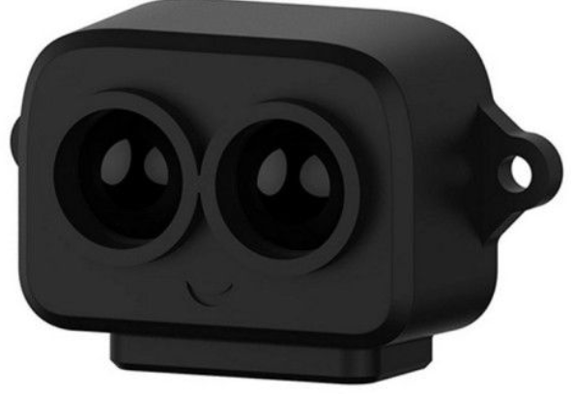
LIDAR Sensor
Light detection and ranging sensor
Relatively affordable (than camera)
Better reliability (than device connected to Wi-Fi)
Simpler implementation (than camera)
Lower power consumption (than camera)
Smaller size providing versatility
Source: https://my.cytron.io/p-tf-luna-tof-lidar-module-8-meters-distance-sensor?r=1&gclid=EAIaIQobChMIlcu8pI308QIVUgwrCh0PSwzoEAQYAiABEgK66fD_BwE

Slide 8
DAQ & Gateway
02
To collect foot traffic data and transfer data to cloud

Slide 9
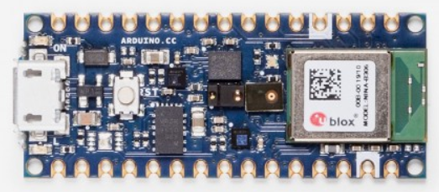

Arduino Nano 33 BLE Sense
Microcontroller (MCU)
Smaller ($45 x 18 mm^{2}$)
Lighter ($5 g$)
Smaller power requirement ($3.3 V$)
Numerous embedded sensors (IMU, Humidity, Temperature, Barometric, Microphone, Gesture, Proximity and Light Sensor)
Embedded AI capabilities (TinyML)
Source: https://store.arduino.cc/usa/nano-33-ble-sense

Slide 10
Edge Analytics
03
To preprocess real-time foot traffic data for simple & quick insights

Slide 11

Edge Impulse (Arduino Nano 33 BLE Sense)
Platform that enables edge computing
Fully utilize sensor data collected
Fully utilize computational capabilities of MCU
Generate real-time insights for individual store:
1. Staff management
2. Staff shifts
3. Restocking
4. Store operation time
Source: https://www.edgeimpulse.com/

Slide 12
Data Center/Cloud
04
To store, process and analyze data from various retail stores for complex insights

Slide 13

Google Cloud IoT
Cost-saving solution that is scalable
Easy integration and connectivity
Data security
Store and archive collected data
Compatible with other GCP functions
Hard core computations (Vertex AI/ AutoML)
Generation of complex insights & predictions
Source: https://cloud.google.com/

Slide 14
CONCLUSION
SENSOR
DAQ & Gateway
Edge Analytics
Cloud
LIDAR Sensor
Arduino Nano 33 BLE Sense
Edge Impulse
Google Cloud IoT

Slide 15
Thank you for your attention.
Questions?

Slide 16
REFERENCES
Jahnke, A. (2020). The 4 Stages of IoT Architecture. Digi. https://www.digi.com/blog/post/the-4-stages-of-iot-architecture
Jongboom, J & Pajak, D. (2020). Edge Impulse makes TinyML available to millions of Arduino developers. Arduino. https://blog.arduino.cc/2020/05/26/edge-impulse-makes-tinyml-available-to-millions-of-arduino-developers/
Kenton, W. (2021). Foot Traffic. Investopedia. https://www.investopedia.com/terms/f/foot-traffic.asp
Sakovich, N. (2021). 10 Best IoT Platforms for 2021. Sam Solutions. https://www.sam-solutions.com/blog/top-iot-platforms/

